Slide 1
STRUCTURED PROGRAMMING CONCEPTS Part 1 - Test1 Portion (Unit 1 and Unit 2)
Essence of Structured Programming Concepts
Header Files and Library files
The Characteristics, Pros, Cons and Applications of C Programming Language
Syntax and Program structure
Data Types
Operators and Expressions
Statements
Arrays
Functions and modular Programming
PDLC and IDE
Programming Languages Paradigm – Structured Programming
Properties of Good Programming Languages
Reasons for Popular Programming Languages

Slide 2
Structured Programming Concepts
C - Introduction
Characteristics of C Language
Features of C Language
Pros and Cons of C
Applications of C
When to Use and When not use C Language for Apps development
C – Syntax Discussion Topics
C Program Structure
Character Set
Coding Scheme
C Tokens
Keywords
Constants and Literals
Identifiers and Variables
Data Types
3. Next Class C Syntax (Expressions, Statements)

Slide 3
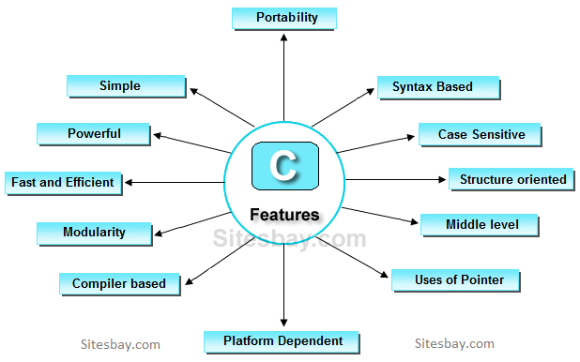
Characteristics of C
The Programming Language ‘C’
is General Purpose Language
is free formatted Language
is relatively type-less Language
is Compact and Standard Language
is Middle-Level Language

Slide 4
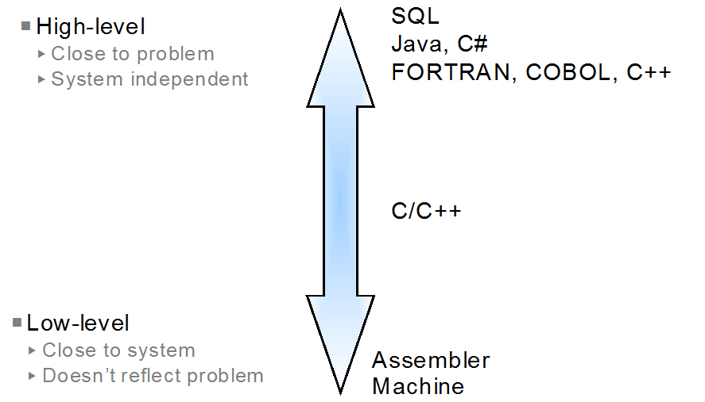
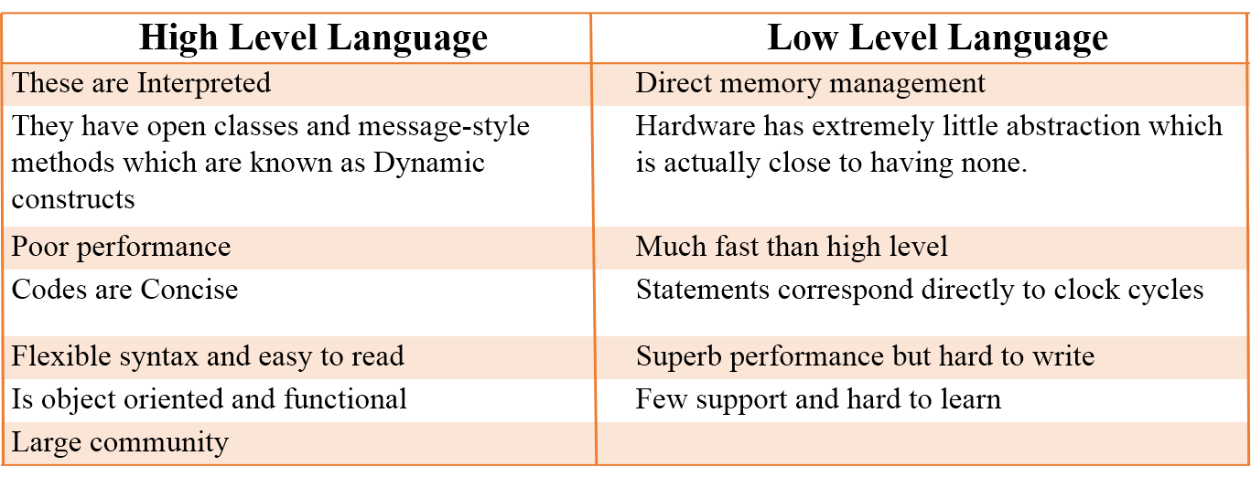

Slide 5
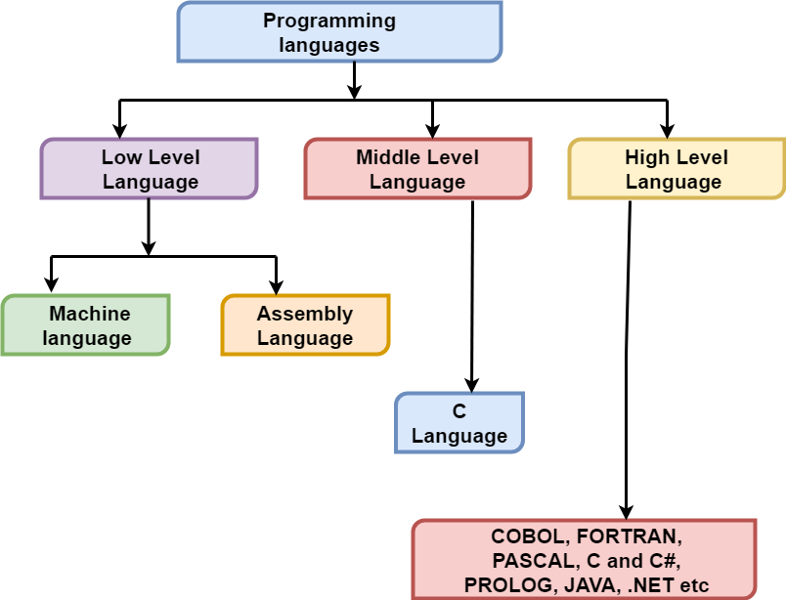
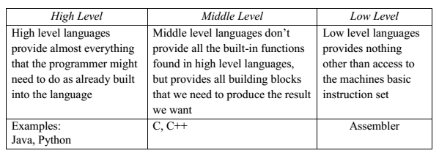

Slide 6
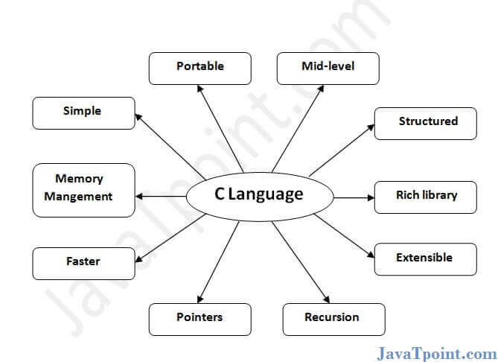

Slide 7
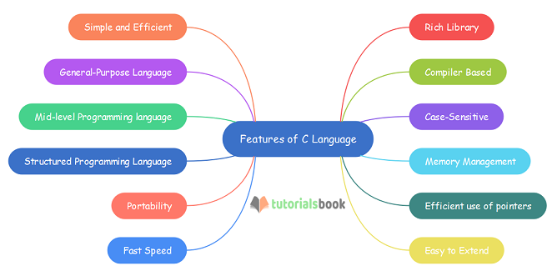

Slide 8
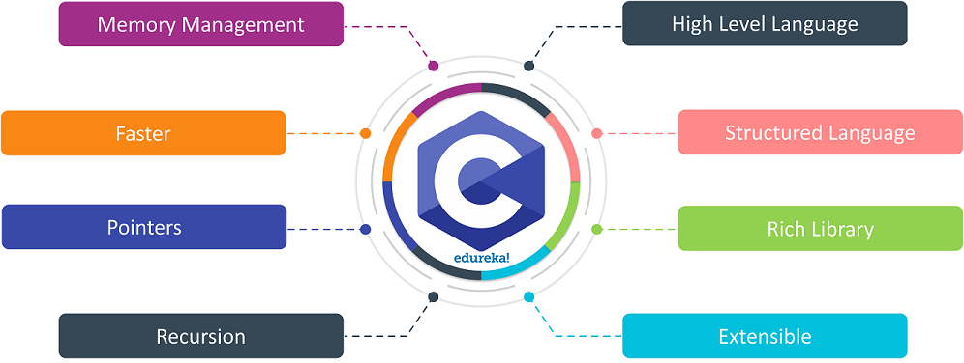

Slide 9
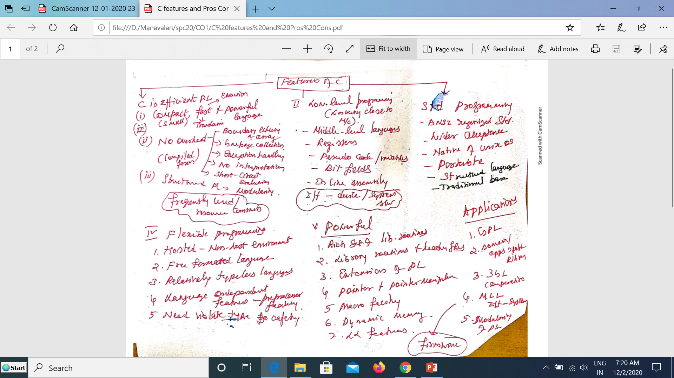

Slide 10
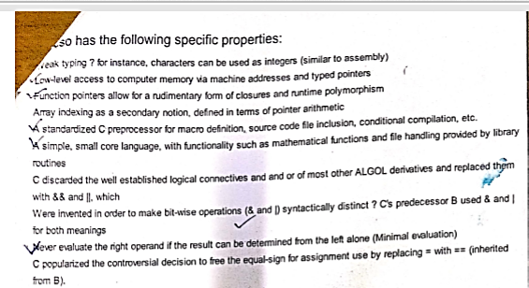

Slide 11
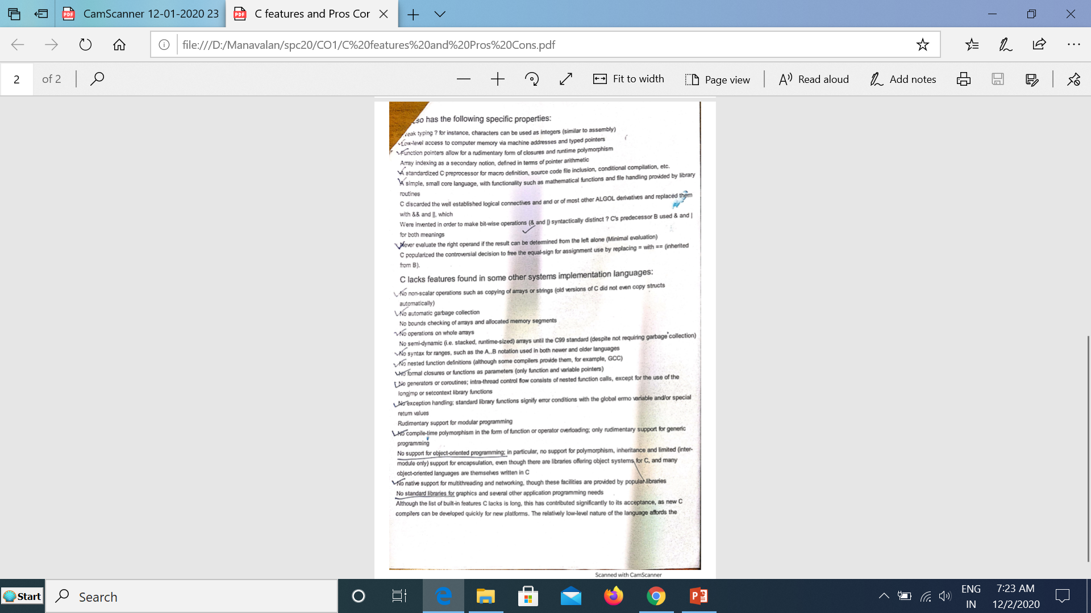

Slide 12
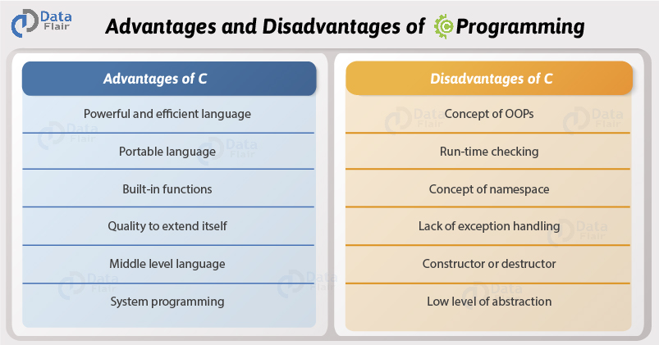

Slide 13
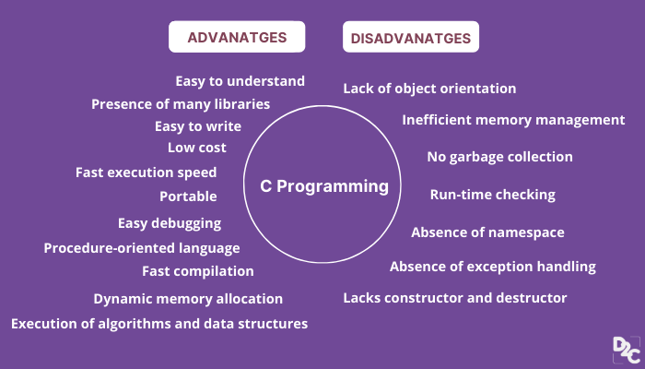

Slide 14
Pros of C Language
1. Portable language: The C programs written in one computer can run on any computer without any change of the program code or having a slight change.
2. Building block for other languages: The C program act as the building block for other programming languages. Programs written in C are more efficient and easy to understand. The underlying principles of C language are applied in other languages.
3. Structured programming language: A C program is a procedure-oriented language with a collection of function modules and blocks that form a complete program. The structured blocks make it easy to debug, test and maintain the program.
4. Easy to learn: It is very easy to learn the C language and acts as the basis for understanding other complex languages. It uses syntax similar to the English language for easy understanding.
5. Built-in function: The C language gives you the opportunity to use several built-in functions in the C library to develop a program. 6. User-defined function: Apart from the standard function in the C library, you can create your own user-defined function to solve a specific problem. Adding more functions in the C library makes your programming work easier.
7. Explore hidden objects: In C program, you can easily access hidden or blocked objects from use by other programming languages.
8. Speed-up programs: Since other languages are based on c program, it speeds up a program which is developed using other programming languages. The programs in C runs faster than in other languages. 9. Compile language: It enables the program code to be compacted into an executable instruction rather being translated by the interpreters. 10. Low level of abstraction: The C programming language is close to system hardware specifications making it easy to know how the higher level language works and interact with the machine.

Slide 15
Cons of C Language
1. Data security: There is a lot of buffer overflow in C language and this can lead to overwriting information in the memory. When pointers are updated with the incorrect data, it will result in memory corruption. 2. No run-time checking: The C language does not allow runtime checking making it difficult to fix the bugs if you extend the program. Mostly it does compile type checking.
3. No strict type checking: When passing data to the parameters, there is no strict data type checking since we can pass an integer value to the parameter. No confirmation of the right data type is used.
4. No code-reuse: C language doesn’t have OOP features which support source code reusability. It doesn’t support constructors and destructors. 5. Namespace concept: C language doesn’t support program namespace thus, it is impossible to declare two variables at the same time like in the C++ program.
6. No OOP concepts: Object-oriented programming concepts like data abstraction, polymorphism, inheritance, and other C++ programming concepts are not supported in the C language. Every algorithm in C is a set of function calls.
7. Effects on Today’s programming: C program does not support enough library functions which can be used to handle today’s complex programming environment like Web Apps. 8. Real-world problems: It cannot be used to solve the real-world programming challenges.
9. Extending the program issues: When you extend the program, it will be very difficult for you to fix any errors and bugs. The C language is effective when dealing with simple projects. 10. High-level constructs: You need to manually create the high-level constructs in C programming language. Third party libraries and other solutions need to be configured before use

Slide 16
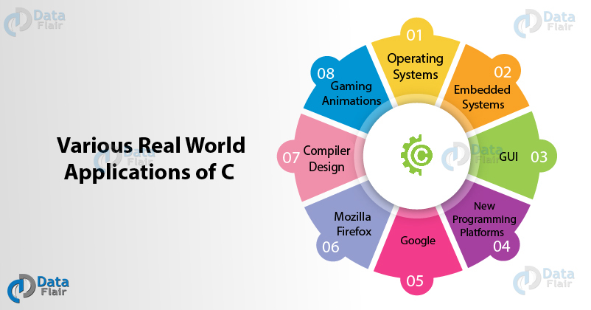
Applications of C Language

Slide 17
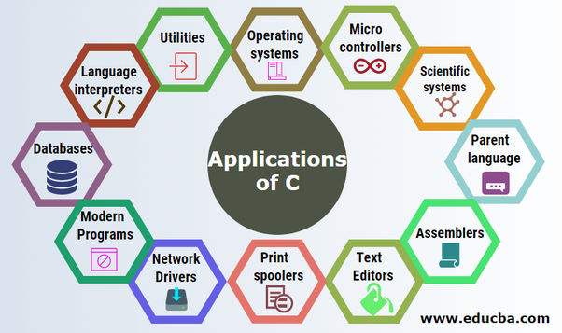
Applications of C Language

Slide 18
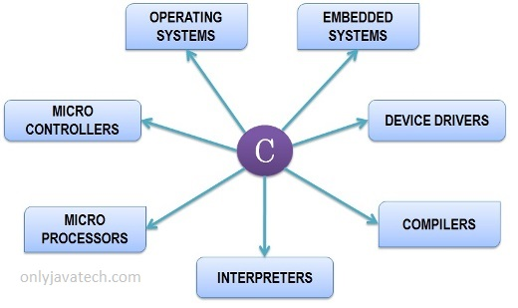
Application Categories of C

Slide 19
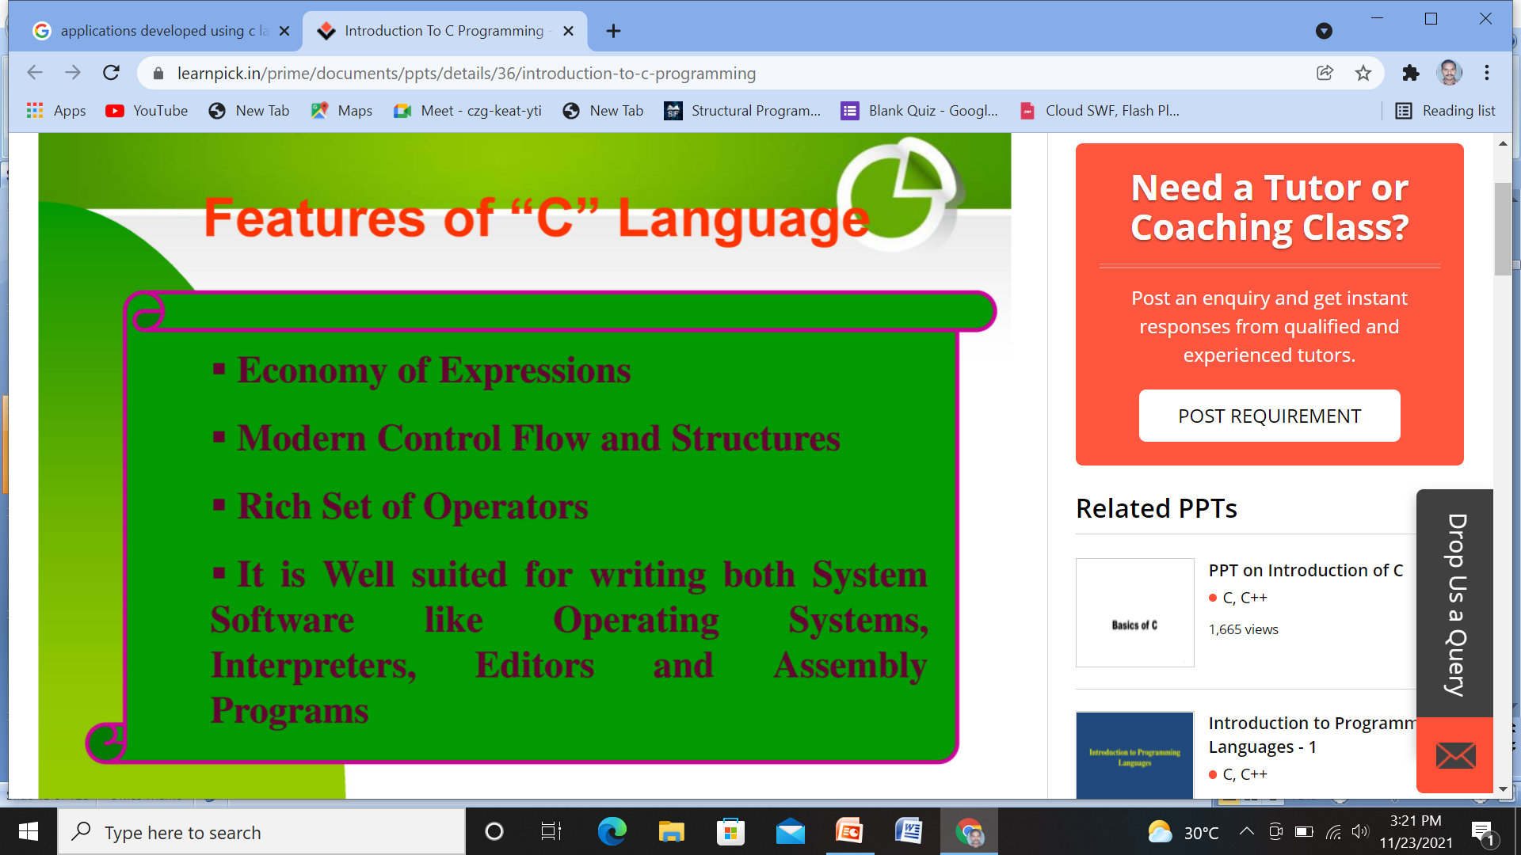
When to Use C Language?
Apps need Efficiency
Apps work Close to Platform (H/W and S/W)
Apps need to violate Data Type Safety
Apps work in Resource Constraint environments
Apps need standalone/Compiled form of Code
Apps need to use Rich Libraries

Slide 20
When not use C Language?
Reliability of Apps are primary Concern
Performance is Not a Concern
Prototyping of Apps
Platform interoperability is very important
Unbearable Apps Code

Slide 21
C applications

Slide 22
Picking The Right Programming Language for Your Apps
1. Type of Application
2. Identify Your Platform
3. Maintainability
4. Scalability, Performance and Security

Slide 23
Benefits of C Language Over Other Programming Languages
C is a powerful programming language that offers several benefits over other languages.
C is a universal language that can be used for various applications.
C is a very efficient language that can write code that is both fast and reliable.
C is a portable language, meaning that code written in C can be easily compiled and run on various platforms.
C is a well-established language with a large and active community of developers constantly working on improving and creating new tools and libraries.
Key Features of C Programming Language
C is a general-purpose computer programming language for system administration, network programming, and embedded software.
It has several features that make it desirable for these applications:
C program syntax is easy to learn and read; this makes debugging code more accessible and faster.
C programs are relatively short compared to other languages, which reduces the time needed to complete them.
C is a powerful programming language that enables developers to create sophisticated software systems.
The language is fast, efficient, and easy to learn, making it a popular choice for many applications.
C is also portable, meaning that programs written in C can be easily ported to other platforms.
C has been around for many years (it was first released in 1979), so many libraries and tools are available that facilitate its use.

Slide 24
Programming Language used ?
Gaming and Animation
Compiler Development
Web Browser
OS and File System
Multimedia Tools

Slide 25
1. Operating Systems:-
What is better than writing your own operating system? And yes, with the help of the C programming language, you can write your own operating system.
Windows Kernel, Linux Kernel and Apple’s OS X kernel are mostly written in C.
2. GUI:-
It stands for Graphical User Interface.
The C programming language also helps in developing popular adobe softwares like Photoshop, Premier Pro, Illustrator etc.
3. Embedded Systems:-
In daily life, we use different embedded systems like coffee machines, microwaves, climate control systems etc.
These all are mostly programmed in C.
4. Database:-
The C programming language helps in developing the popular database management system, MySQL.
5. Ease of Computation:-
C provides faster computation in programs.
The implementation of algorithms and data structures is swift in C.
With the help of C, you can perform high degree calculations such as MATLAB, Mathematica etc.
6. Gaming and animation
C programming is relatively faster than Java or Python.
It has been used in various gaming applications and graphics.
C programming language also helps in creating many popular childhood games like Tic-Tac-Toe, The Snake game etc.

Slide 26
7. Development of New languages:-
Due to the fast execution and simplicity, many languages like Java, C++, Python, PHP, PERL, JavaScript, etc were influenced by the development of C.
In Python, C is used for building standard libraries.
The syntax and control structures of PERL, PHP and C++ are based upon the C programming language.
8. Google:-
In the Google open source community, the projects are being handled by C/C++.
C/C++ also helped in developing google file system and chromium browser.
9. Assemblers:-
Mainly used to translate Assembly language to Machine language.
C also helped in developing GNU assembler.
10. Text Editors:-
C also helped in creating various text editors like Vim, Gedit etc.
11. Drivers:-
Another application of C is to write driver softwares like Keyboard driver, Network driver, mouse driver etc.
12. Interpreters:-
With the help of C programming language, you can create language interpreters.
C helped in developing different programming language interpreters like Python and MATLAB interpreters etc.
13. Network Devices:-
Another application of C is to design network devices.
14. Compiler Design:-
C also helped in designing several popular compilers like Clang C, MINGW, Apple C etc.
This is one of the most popular uses of C language

Slide 27
C is one of the fastest and most simple programming languages.
C is fast, portable and has a rich library. Being one of the oldest, it is still preferred by many companies and backend developers.
C programming language is being used in every domain such as hardware and software development, embedded systems, databases etc. For some of exciting real-world applications of C.
Development of video games
Applications using graphical user interfaces
Databases and computer operating systems
Browsers on the internet
Computational and graphical methods
Banking
Cloud computing and distributed systems
Compilers
Embedded systems are systems that are integrated into a larger system.
Integrated software libraries for enterprises
Server applications on a large scale
Platforms for new programming languages

Slide 28
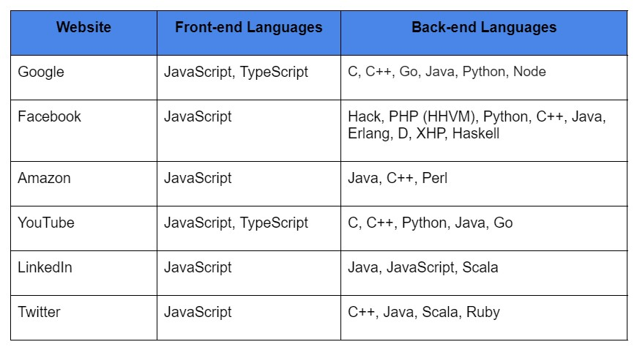
https://en.wikipedia.org/wiki/Programming_languages_used_in_most_popular_websites

Slide 29
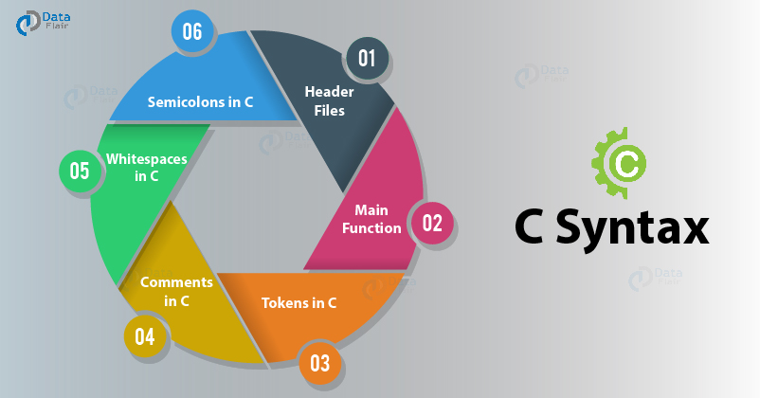
C program syntax is easy to learn and read; this makes debugging code more accessible and faster.
C programs are relatively short compared to other languages, which reduces the time needed to complete them.

Slide 30
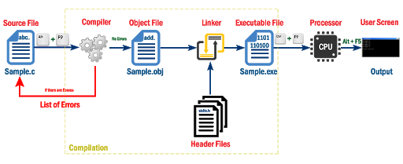
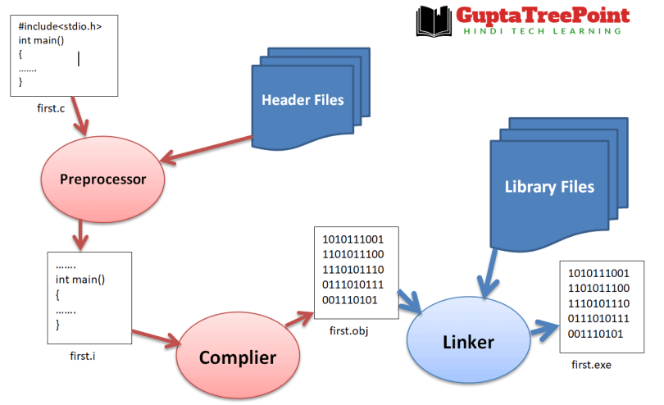
What is Wrong with the following Diagram1?

Slide 31
What is Header File?
A Header file is a text file with name extension H (.h) which contains declarations of Functions, Standard Variables and Constants and Macros.(Human Readable Source Code form)
The Header files to be shared with multiple files in order to reuse the declarations in multiple files
Header files tell the Compiler how to Call some outside functionality without knowing how the functionality works.
The preprocessor directive #include is used to include Header files in C programs
Using either the < and > for relative path or “ and “ for absolute Path of Header files

Slide 32
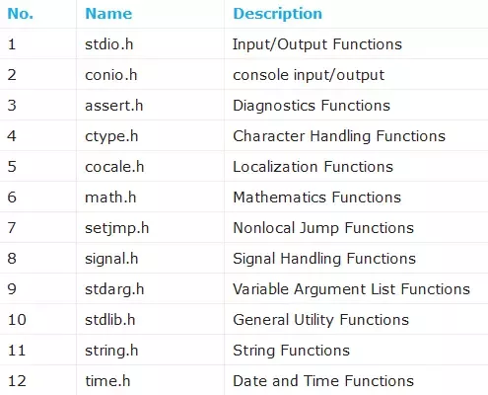
Standard Header files

Slide 33
Important Header Files in C
1. #include<stdio.h> (Standard input-output header)
Used to perform input and output operations in C like scanf() and printf().
2. #include<string.h> (String header)
Perform string manipulation operations like strlen and strcpy.
3. #include<conio.h> (Console input-output header)
Perform console input and console output operations like clrscr() to clear the screen
and getch() to get the character from the keyboard.
4. #include<stdlib.h> (Standard library header)
Perform standard utility functions like dynamic memory allocation, using functions
such as malloc() and calloc().
5. #include<math.h> (Math header )
Perform mathematical operations like sqrt() and pow(). To obtain the square root
and the power of a number respectively.
6. #include<ctype.h>(Character type header)
Perform character type functions like isaplha() and isdigit(). To find whether the given
character is an alphabet or a digit respectively.
7. #include<time.h>(Time header)
Perform functions related to date and time like setdate() and getdate().
To modify the system date and get the CPU time respectively.

Slide 34
Important Header Files in C – Cont’d
8. #include<assert.h> (Assertion header)
It is used in program assertion functions like assert().
To get an integer data type in C/C++ as a parameter which prints stderr only if the parameter passed is 0.
9. #include<locale.h> (Localization header)
Perform localization functions like setlocale() and localeconv().
To set locale and get locale conventions respectively.
10. #include<signal.h> (Signal header)
Perform signal handling functions like signal() and raise().
To install signal handler and to raise the signal in the program respectively
11. #include<setjmp.h> (Jump header)
Perform jump functions.
12. #include<stdarg.h> (Standard argument header)
Perform standard argument functions like va_start and va_arg().
To indicate start of the variable-length argument list and to fetch the arguments from
the variable-length argument list in the program respectively.
13. #include<errno.h> (Error handling header)
Used to perform error handling operations like errno().
To indicate errors in the program by initially assigning the value of this function to 0 and then later changing it to indicate errors.

Slide 35
What is Library File?
Library is the place where the actual functionality is implemented (Machine readable Binary Form)
The Library files are used define the functions declared in header files.
Main two Categories: Static and Dynamic (Shared)
“A library is basically just an archive of object files. And is made up of useful and reusable code.”
“The library therefore consists of an interface expressed in a .h file (named the "header") and an implementation expressed in a .c file.”
“If you have a bunch of files that contain just functions, you can turn these source files into libraries that can be used statically or dynamically by programs”.
This is good for program modularity, and code re-use. Write Once, Use Many.

Slide 36
Library of C
A library in C is a collection of header files, exposed for use by other programs.
The library therefore consists of an interface expressed in a .h file (named the "header") and an implementation expressed in a .c file.
This .c file might be precompiled or otherwise inaccessible, or it might be available to the programmer. (Note: Libraries may call functions in other libraries such as the Standard C or math libraries to do various tasks.)
The format of a library varies with the operating system and compiler one is using.
For example, in the Unix and Linux operating systems, a library consists of one or more object files, which consist of object code that is usually the output of a compiler (if the source language is C or something similar) or an assembler (if the source language is assembly language).
These object files are then turned into a library in the form of an archive by the archiver (a program that takes files and stores them in a bigger file without regard to compression).
The filename for the library usually starts with "lib" and ends with ".a"; e.g. the libc.a file contains the Standard C library and the "libm.a" the mathematics routines, which the linker would then link in.
Other operating systems such as Microsoft Windows use a ".lib" extension for libraries and an ".obj" extension for object files.
Some programs in the Unix environment such as lex and yacc generate C code that can be linked with the libl and liby libraries to create an executable.

Slide 37
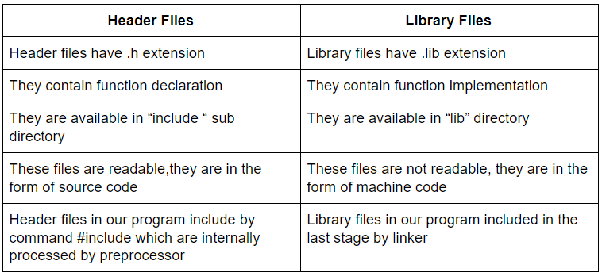
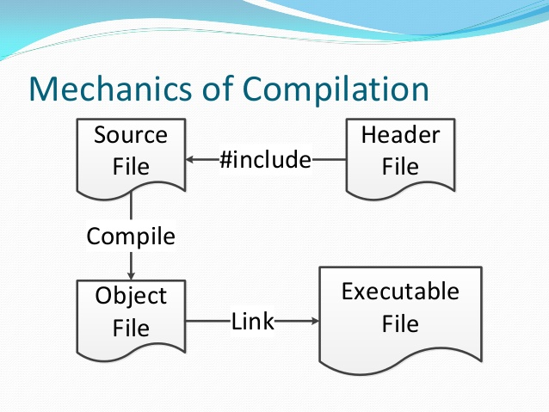
Header File Vs. Library File
Reuse the Declarations - Reuse the Implementations

Slide 38
Why Header files?
Separation Of Concern(SoC) between Developer and Consumer
Interface and Implementation
Reuse / Share the declarations in Multiple files
Modularity
Standard coding Practices like Naming etc.,
Extension of Programming Language
Standard and Custom
Optimization of Resources
By grouping the related things as a Unit
To Get Static or Dynamic Linking of Code

Slide 39
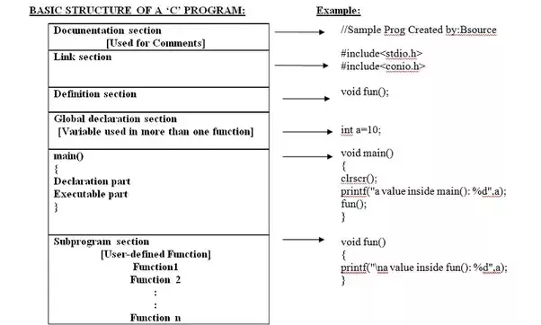

Slide 40
Various Sections of a C Program
Documentation Section
It contains the comment lines.
Preprocessor Section
It is used to link library files.
Global Declaration Section
The Global declaration section comes at the beginning of the program and they are visible to all parts of the program.
Declaration Section
It describes the data to be used within the function.
Executable Part
It contains the valid statements.

Slide 41
C Programs
C program may have many functions.(i.e. Collection of Functions)
One and only one of the functions MUST BE named main.
main is the starting point and End point for the program.
main and other functions in a program are divided into two sections, declaration section and statement section.
The arguments of main() are argc, argv and environment.
The main () function is called by _main or _init function depends on version.
main () opens five files namely stdin, stdout, stderr, stdaux and stdprn. Also process the Command line arguments.

Slide 42
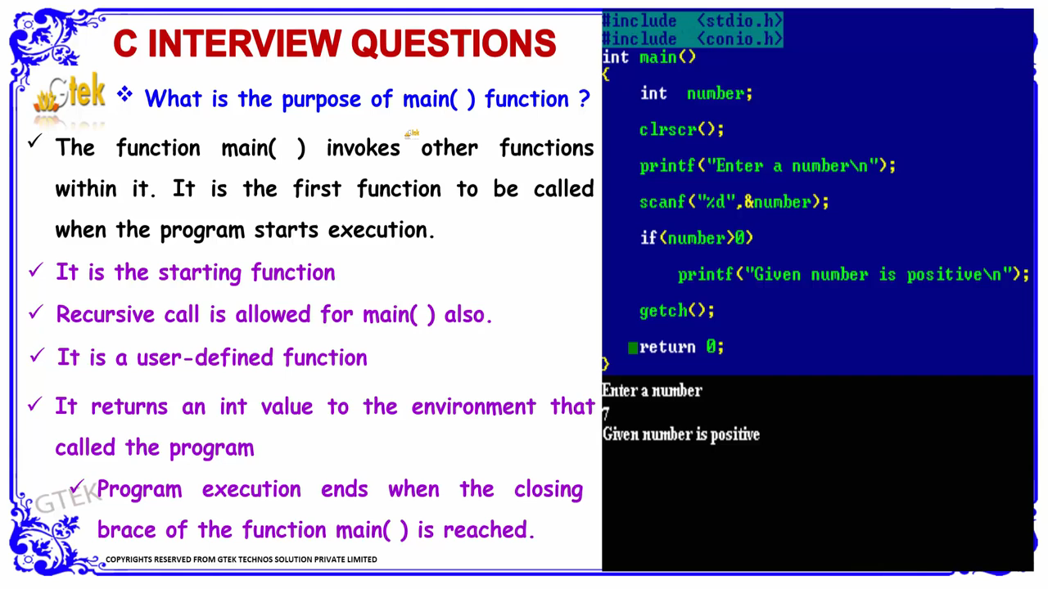
What is the purpose of main() function in C

Slide 43
Preprocessor Directives
Special instructions to the preprocessor that tells how to prepare the program for compilation
E.g: include : tells the processor to include information from selected libraries known as header files e.g. <stdio.h>

Slide 44
Comments (Program documentation)
The compiler simply ignores comments when it translates the program into executable code.
To identify a comments, C uses opening /* and closing */ comment tokens.
Comments can appear anywhere in a program.
Comments are also found wherever it is necessary to explain a point about a code.
Comments cannot be nested in C i.e. you cannot have comments inside comments.

Slide 45
C program
/* Example program in C*/ Comments
# include <stdio.h> Preprocessor Section
Global Declaration
void main ()
{ Local declaration
printf (“Hello World! \n”); Statements
}
Output :
Hello World

Slide 46
Steps in Executing a C Program
Creating the Program
Compilation
Linking
Execution

Slide 47
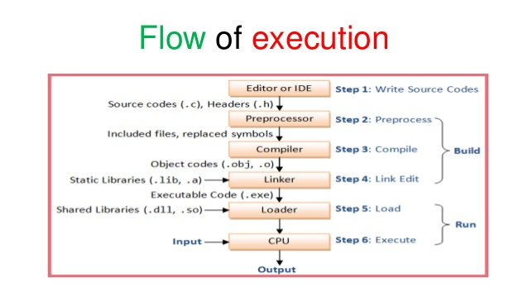
Flow of Execution of C programs

Slide 48
Steps in learning C Syntax
Character
Set
Tokens
Instructions
Expressions
Statements
Functions
Programs

Slide 49
Character Set of C
A well-defined set of characters recognized by H/W or S/W or both together is called Character set
The set of Characters used to create a C source Program is called Source Character Set
The set of Characters used to Executes a C Program is called Executable Character Set
In order to store, process and display Character data it needs a Coding Scheme which gives values for each character.

Slide 50
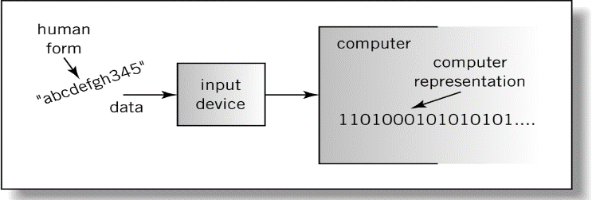
What is Coding Scheme?
Translation & reverse translation
Translation to binary during input
Reverse translation during Output(display)
Problem: A same pattern of bits can represent a character, a color, a sound, etc.
Solution: Data formats (i.e. detailed description of the data and their representation) help interpret the reverse translation

Slide 51
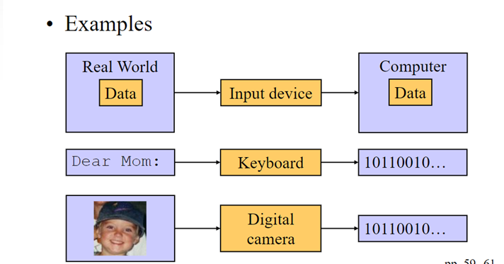

Slide 52
Which Coding Scheme ?
At the lowest level, everything in a computer is represented by 0s and 1s called Bits. BIT – Binary digIT
The internal representation of a list of characters/ Symbols is Called Coding Scheme
Coding scheme may be Proprietary formats like MS Word, IBM Lotus Notes etc or Standard formats from ISO, ANSI, IEEE and etc.
The order of the Characters / Symbols in a Coding scheme is Called Collating Sequence.
Type of Data | Standards
Alphanumeric | ASCII, EBCDIC, Unicode
Image | JPEG, GIF, PCX, TIFF
Motion Picture | MPEG-2 Quick Time
Sound | WAV, Sound Blaster
Outline graphics /fonts | PostScript, PDF, True type

Slide 53
C Character Set
Source Character Set
It is used to construct the statements in the program.
Executable Character Set
These characters are employed at the time of execution i.e. they have effects only when the program is being executed.

Slide 54
C Character Set
C Character Set
Source
Character Set
Execution
Character Set
Alphabets
Digits
Special
Characters
White
Spaces
Escape
Sequence

Slide 55
Source Character Set
Letters | a to z ,A to Z
Digits | 0 to 9
Special Characters | ! @ # $ % ^ & * ( ) _ - + = \ | { } [ ] etc,.
White Spaces | Blank Space ,Horizontal tab, New line, Vertical tab etc,.
The Source Character Set of C represents alphabet, digit or any symbol used to represent information.

Slide 56
Special characters
Comma ,
Period or dot .
Semicolon ;
Colon :
Apostrophe ‘
Quotation mark “
Exclamation mark !
Vertical bar |
Back Slash \
Tilde ~
Underscore -
Dollar $
Question mark ?

Slide 57
Special Characters –Cont’d
Ampersand &
Caret ^
Asterisk *
Minus -
Addition +
Lesser than <
Greater than >
Parenthesis ()
Bracket []
Braces {}
Percentage %
Hash #
Equal to =
At the rate @

Slide 58
Executable Character Set
Executable Character Set includes Source Character Set Plus the following
Characters | Escape Sequence
Back Space | \b
Horizontal Space | \t
Vertical Space | \v
Newline End of File | \n ^Z or ^D

Slide 59
C Tokens
The smallest element in the C language is the token
It may be a single character or a sequence of characters.
A collection of Valid Characters with meaning
Rules for Token forming includes either delimiters like White Spaces or Longest possible character formation
e.g. In a++++b, token are a, ++, ++ and b
e.g. In a ++ + ++ b, tokens are a, ++, +, ++ and b
Tokens are some of the most significant components utilized in the C programming language.
Tokens in C are the smallest individual components of a program that are relevant to the operation of a compiler.
Every punctuation mark and word in a C program is a token.
A compiler converts a C program into tokens before moving on to the next steps of the compilation process.

Slide 60
C Tokens Types
C Tokens
Identifiers
Eg:main,
avg
Keywords
Eg: int,
for
Constants
Eg:17,
15.5
Strings
Eg: “ab”
operators
Eg: +
-
spI
symbol
Eg: #
$ %

Slide 61
Identifiers @ Programming Language
Keywords, Standard Identifiers and User Defied Identifiers
Keywords
Keywords are the reserved words whose meaning has already been explained to the C compiler.
We cannot use these keywords as variables.
Each keyword is meant to perform a specific function in a C program.
There are 32 keywords in C language.
All keywords are written in lowercase only
Eg: The name of person can never be home, eat, sleep, run, etc because these words have some predefined meaning to perform some task.

Slide 62
List of C Keywords
auto | double | int | struct
break | else | long | switch
case | enum | register | typedef
char | extern | return | union
const | float | short | unsigned
continue | for | signed | void
default | goto | sizeof | volatile
do | if | static | while

Slide 63
What is the use of both ‘const’ and ‘volatile’?
volatile will tell the compiler not to optimize code related
the variable, usually when we know it can be changed from "outside",
e.g. by another thread.
const will tell the compiler that it is forbidden for the program to modify
the variable's value.
const volatile is a valid and very special thing. As is to be expected,
it means that the program cannot modify the variable's value,
but the value can be modified from the outside, thus no optimizations
will be performed on the variable.
E.g. extern const volatile int real_time_clock;
where real_time_clock may be modifiable by hardware,
but cannot be assigned to, incremented, or decremented. In the program

Slide 64
Constants
It is an entity whose value does not changes during the execution.
Eg: x=3
Here 3 is a Literal constant.
Literals are fixed values (Constants) with out a name. e.g. 5, ‘a’, 6.7
Named Constants are fixed Values with a name provided by a declaration using the keyword ‘const’ e.g. int const c =5;
All constants represents memory locations with two attributes value and Name & Content.

Slide 65
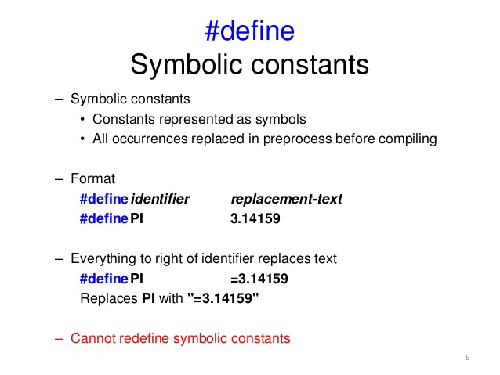
This is not part of C Language
Is it valid in a C program ?
#define for 25

Slide 66
Is it possible to use keywords as Symbolic Name(macro name)?
The answer is Yes. Because all macros are processed by preprocessor before the translation.
The limitation of this is we can’t use the keyword in the program. Because all appearance of macro names except comments and string constants are replaced by the text substitution of macro body by processor before translation.

Slide 67
Literals or Constants
The entity which do not change throughout the execution are called constants.
Types of constants:
Integer constant
Character constant
Floating point constants
String constants
Name of person remains same through out the life, example: Amit, Shubnam, etc.

Slide 68
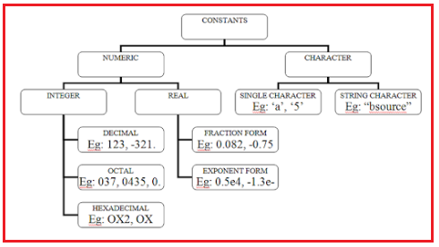
Types of Literals or Constants
All Backslash constants are under Single character Constants
E.g. ‘\n’, ‘\005’

Slide 69
Numeric constants
Integer constants
It is formed using a sequence of digits.
Decimal - 0 to 9 .
Octal - 0 to 7.
Hexa - 0 to 9 ,A to F
Eg: 10,75 etc.

Slide 70
Rules for defining Integer Constant
It must have at least one digit.
Decimal point are not allowed.
No blank space or commas are allowed.
It can be either positive or negative. Etc,.
The allowable prefix is – and suffix is l or L to indicate
Long integer.
e.g. -123l, 12L

Slide 71
Numeric constants
Real constants
It is formed using a sequence of digits but it contain decimal point.
length, height, price distance measured in real number
Eg: 2.5, 5.11, etc.
The data type is double.
Two Notations namely Scientific or floating point used
eg: 1.2e-7, 1.0000006

Slide 72
Character constants
Single character constant
A character constant is a single character they also represented with single digit or a single special symbol which is enclosed in single quotes.
Eg: ‘a’, ‘8’,’_’etc.
It includes ALL Backslash Characters
E.g. ‘\n’,

Slide 73
String constants
String constant are sequence of characters enclosed with in double quote.
Eg: “Hello” ,”444”,”a” etc,.
Null Character terminated Strings

Slide 74
C IDENTIFIERS
Is a unique name that simply references to memory locations, which can hold values (data).
Identifiers give unique names to various objects in a program.
Are formed by combining letters (both upper and lowercase), digits (0–9) and underscore ( _ ).
Rules for identifier naming are:
The first character of an identifier must be a letter (non-digit) including underscore ( _ ).
The blank or white space character is not permitted in an identifier. Space, tab, linefeed, carriage-return, form-feed, vertical-tab, and newline characters are "white-space characters“ - they serve the same purpose as the spaces between words and lines on a printed page.
Can be any length but implementation dependent.
Reserved words/keywords cannot be used.

Slide 75
C IDENTIFIERS
Examples: variable names
Correct | Wrong
secondName | 2ndName /* starts with a digit */
_addNumber | %calculateSum /* contains invalid character */
charAndNum | char /* reserved word */
annual_rate | annual rate /* contains a space */
stage4mark | my\nName /* contains new line character, \n */

Slide 76
Identifiers
So to identify things we have some name given to them .
Identifiers are the fundamental building blocks of a program
Identifiers are names given to various program elements such as variables, functions and arrays etc,.
They are user-defined names and consist of a sequence of letters, digits and Underscore(_)
Three Categories of Identifiers are Reserved Words, Standard Identifiers and User Defined identifiers
Notes:
Variable is data name used for storing a data value

Slide 77
Rules for naming an Identifier
1. An identifier name is any combination of 1 to 31 alphabets, digits or underscores (Version Dependent Length )
2. The first character in the identifier name must be an alphabet or underscore.
3. No blanks or special symbol other than an underscore can be used in an identifier name.
4. Keywords are not allowed to be used as identifiers.
4. Conventions _ means System defined external Identifiers
_ _ means Builtin Identifiers

Slide 78
Some Identifiers
Tool_spanner;
tool_spanner;
FORMULA1;
engine_1;
both are different
Wrong identifiers name
1_engine;
break;
@car-roof;

Slide 79
Rules for naming identifier
First character must be alphabetic or underscore.
Must consist only of alphabetic characters, digits, or underscores.
Only the first 31 characters of an identifier are significant and are recognized by the compiler.
Cannot use a keywords or reserved word (e.g. main, include, printf & scanf etc.).
No space are allowed between the identifiers etc,.
C is case sensitive, e.g. My_name ≠ my_name.

Slide 80
Examples of Valid and Invalid Names

Slide 81
Data Types
A Data type is the type of data that are going to access within the program by providing values, operations and attributes.
A Data type is a set of values with allowable set of operations.
All values of data type with common properties like memory size, format, range of values and operations
Abstract Data Type(ADT) provide separation between Operations and values representation.
Data type in declarations is used to detection of errors, type safety, and verification.

Slide 82
Classification of Data Types
In C data type is broadly classified as:
Basic data types
Derived data types
User defined data types
C Data types classified based on Values (content)
Void – Valueless
Value - Scalar types (One value at a time)
Arithmetic value is content types
Ordinal type ( Counting is Possible)
Character, Integer, Enumeration
Non-Ordinal type
Float, Double
Memory address is content - Pointer
Size: Near, Far and Huge Pointers
Target : Void Pointer and Normal Pointer
Locations NULL pointer and Non- NULL pointer
Code is content Function Type
Aggregate Data types
Mono data type - Arrays
Multiple data types – Structures and Unions

Slide 83
Data Type
Basic Data Type
Integer
Character
Float
Double
Derived Data Type
Pointers
Functions
Array
User Defined Data Type
Structure
Union
Enumeration

Slide 84
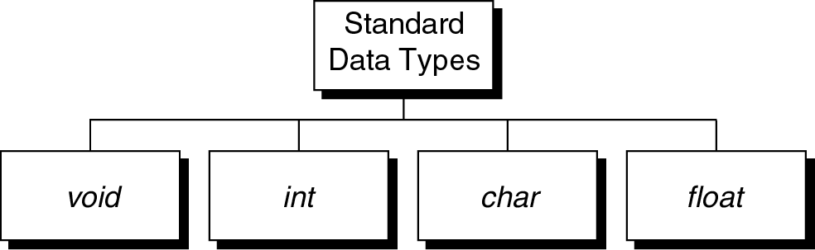
Standard Data Types
These Standard type can be used to build more complex data types called Derived Types (e.g. pointers, array, union etc.).

Slide 85
Data types in c
Data type Size(bytes) Range Format string
Char 1 128 to 127 %c
Unsigned char 1 0 to 255 %c
Short or int 2 -32,768 to 32,767 %i or %d
Unsigned int 2 0 to 65535 %u
Long 4 -2147483648 to 2147483647 %ld
Unsigned long 4 0 to 4294967295 %lu
Float 4 3.4 e-38 to 3.4 e+38 %f or %g
Double 8 1.7 e-308 to 1.7 e+308 %lf
Long Double 10 3.4 e-4932 to 1.1 e+4932 %lf

Slide 86
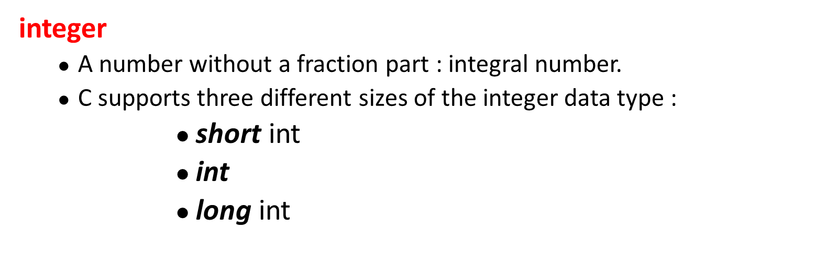
void
The void type has no values and no operations.
Both the set of values and the set of operations are empty.

Slide 87
Floating Point
A floating-point type is a number with a fractional part, e.g. 56.78
Floating point numbers are stored using
4 Byte.
Types
Float
Double
long double

Slide 88
Character
Character are generally stored using 8 bits(1 Byte) of the internal storage.
Character ASCII code value
a 97(decimal) or 01100001(binary)
x 120(decimal) or 01111000(binary)

Slide 89
Variable’s Declaration
To create a variable, you must specify the type and then its identifier :
float price;
int a,b;
char code;

Slide 90
C VARIABLES
are named blocks of memory & is any valid identifier.
Have two properties in syntax: name — a unique identifier & type — what kind of value is stored.
It is identifier, that value may change during the program execution.
Every variable stored in the computer’s memory has a name, a value and a type.

Slide 91
Variables
Variable is an identifier that is used to represent some specified type of information.
Eg: x=3
Here x is variable.
Life cycle of a variable / identifier includes three stages
Declaration – Specify the name and Data Type. It is a Translation process
Definition - memory allocation with / without Initialization. It is Binding which is an execution process.
Referencing / Using i.e. accessing a available
Forward Reference - Declare and Use a variable e.g. in C?
Backward Reference Use and then declare a variable. e.g. in C?
Re-declaration and Re-definition is illegal and will get Compile error.

Slide 92
Literals | Constants | Variables
Examples 5, 4.5, ‘a’, “Good” | Int const a=5; char const c=‘q’; | int v,j; char c[12];
Unnamed memory locations where storing and retrieval by using the Value | Named memory locations where initialization and retrieval by using the Name | Named memory locations where storing, modifying and retrieval by the Name
Memory location with two attributes namely address and Value(content as well as name) | Memory location with three attributes namely address and Value and name. But assignment or modification is not allowed. | Memory location with three attributes namely address and Value and name. But assignment or modification is allowed multiple times during execution
Declaration is not required | Declaration with initialization is required | Declaration with or with out initialization is required. Optionally with multiple modification(assignment)
R Value means only Assignable | Non-modifiable L value . .i.e Assignable and addressable. | Simply L – Value means modifiable. Assignable, Modifiable and Addressable
Black Box (Data type is implicit) | Gray Box (Explicit data type) | White Box (Explicit Data type)
Usage: Few places with read only values | Usage : Few places only one value at execution time. for e.g. PI | Usage: Many places with multiple values at execution time

Slide 93
Expression
An expression represent data item such as variable, constant are interconnected using operators.
Eg:
Expression | C Expression
a + b + c | a + b + c
a²+b² | a*a + b*b

Slide 94
Operators
An operator is a symbol that specifies an operation to be performed on the operands.
Eg: a + b
+ is an operator.
a,b are operands.

Slide 95
Operators
Operator is the symbol which performs some operations on the operands.
5+5=10
+ and = are the operator and
5 and 10 are operands
The Properties of Operators
Arity – means Number of Operands -Unary, Binary and Ternary Operators
Hierarchy - Priority (Order) of Execution - 14 Levels of Priority
Associativity – Direction of Execution Left to Right or Right to Left
Side effect – Active / Passive Operators
Sequence Point – Legal Violations of Normal Rules
e.g. Logical and - &&, Logical or || Conditional Operator ?: and parentheses – ( ).

Slide 96
Types of Operators
Types of operators are:
Arithmetic operator
Unary operator
Relational operator
Logical operator
Assignment operator
Conditional operator
Bitwise operator
Special operator

Slide 97
Operator Precedence & Associativity
The arithmetic expressions evaluation are carried out based on the precedence and associativity.
The evaluation are carried in two phases.
First Phase: High Priority operators are evaluated.
Second Phase: Same Priority operators are evaluated based on associativity.

Slide 98
Precedence of Operators
The precedence of operators determine a rank for the operators. The higher an operator's precedence or priority, the higher ibinding it has on the operands.
Example: So how the expression a * b + c will be interpreted?
(a * b) + c or a * (b + c),
here the first interpretation is the one that is used because the multiplication operator has higher precedence than addition.

Slide 99
Associativity of Operators
Associativity tell us the order in which several operators with equal precedence are computed or processed in two directions, either from left to right or vice-versa.
Example: In the expression
a * b / c,
since multiplication and division have the same precedence we must use the associativity to determine the grouping. These operators are left associative which means they are grouped left to right as if the expression was
(a * b) / c.

Slide 100
Precedence or Hierarchy of Operator (order of Execution)and Associativity of Operators(Direction of Execution)
Operator | Associativity | Type
() [] . -> ++(postfix) - - (postfix) | left to right | Highest
+ - ++ -- ! & * ~ sizeof (type) | right to left | Unary
* / % | left to right | multiplicative
+ - | left to right | additive
<< >> | left to right | shifting
< <= > >= | left to right | relational
== != | left to right | equality
& | left to right | bitwise AND
^ | left to right | bitwise OR
| | left to right | bitwise OR
&& | left to right | logical AND
|| | left to right | logical OR
?: | right to left | conditional
= += -= *= /= &= |= ^= <<= >>= %= | right to left | assignment
, | left to right | comma

Slide 101
Description of Operators
Arithmetic Operators
These are binary operators i.e. expression requires two operands
Operator | Description | Example (a=4 and b=2)
+ | Addition of two operands | a + b = 6
- | Subtraction of two operands | a – b = 2
* | Multiplication of two operands | a * b = 8
/ | Division of two operands | a / b = 2
% | Modulus gives the remainder after division of two operands | a % b = 0

Slide 102
Unary Operator
These operator requires only one operand.
Operator | Description | Example(count=1)
+ | unary plus is used to show positive value | +count; value is 1
- | unary minus negates the value of operand | -count; value is -1
++ | Increment operator is used to increase the operand value by 1 | ++count; value is 2 count++; value is 2
-- | Decrement operator is used to decrease the operand value by 1 | --count; value is 1 count--; value is 1
++count increments count by 1 and then uses its value as the value of the expression. This is known a prefix operator.
count++ uses count as the value of the expression and then increments count by 1. This is known as postfix operator.

Slide 103
Relational Operator
It compares two operands depending upon the their relation. Expression generates zero(false) or nonzero(true) value.
Operator | Description | Example (a=10 and b=20)
< | less than, checks if the value of left operand is less than the value of right operand, if yes then condition becomes true. | (a < b) value is 1(true)
<= | less than or equal to, checks if the value of left operand is less than or equal to the value of right operand, if yes then condition becomes true. | (a <= b) value is 1 (true).
> | greater than, checks if the value of left operand is greater than the value of right operand, if yes then condition becomes true. | (a > b) value is 0 (not true).
>= | greater than or equal to, checks if the value of left operand is greater than or equal to the value of right operand, if yes then condition becomes true. | (a >= b) value is 1 (true).
== | equality ,checks if the value of two operands is equal or not, if yes then condition becomes true. | (a == b) value is 0 (not true).
!= | inequality, checks if the value of two operands is equal or not, if values are not equal then condition becomes true. | (a != b) value is 1 (true).

Slide 104
Logical Operator
It checks the logical relationship between two expressions and the result is zero( false) or nonzero(true).
Operator | Description | Example
&& | Logical AND operator. If both the operands are true then condition becomes true. | (5>3 && 5<10) value is 1 (true).
| | | Logical OR Operator. If any of the two operands is true then condition becomes true. | (5>3 || 5<2) value is 1 (true).
! | Logical NOT Operator. Use to reverses the logical state of its operand. If a condition is true then Logical NOT operator will make false. | !(8==8) value is 0 (false).

Slide 105
Assignment Operator
They are used to assign the result of an expression on right side to a variable on left side.
Operator | Description | Example(a=4 and b=2)
+= | a=a+b | a+=b; a=a+b = 6
-= | a=a-b | a-=b; a=a-b = 2
*= | a=a*b | a*=b; a=a*b = 8
/= | a=a/b | a/=b; a=a/b = 2
%= | a=a%b | a%=b; a=a%b = 0
>>= | a=a>>b | a=00000100 >> 2 = 00010000
<<= | a=a<<b | A=00000100 << 2 = 00000001
&= | a=a&b | (a=0100, b=0010) a&=b; a=a&b = 0000
|= | a=a|b | (a=0100, b=0010) a|=b; a=a|b =0110
^= | a=a^b | (a=0100, b=0010) a^=b; a=a^b = 0110

Slide 106
Conditional Operator
Conditional operator contains condition followed by two statements. If the condition is true the first statement is executed otherwise the second statement.
It is also called as ternary operator because it requires three operands.
Operator | Description | Example
?: | conditional expression, Condition? Expression1: Expression2 | (a>b)? “a is greater”: “b is greater”

Slide 107
Bitwise Operator
A bitwise operator works on each bit of data.
Operator | Description | Example(a=1 and b=0)
& | bitwise AND | a & b = 0
| | bitwise OR | a| b = 1
^ | bitwise XOR | a ^ b = 1
~ | bitwise one’s complement | ~a = 0, ~b=1
<< | bitwise left shift, indicates the bits are to be shifted to the left. | 1101 << 1 = 1010
>> | bitwise right shift, indicates the bits are to be shifted to the right. | 1101 >> 1 = 0110
Logical Table
a | b | a & b | a | b | a ^ b
0 | 0 | 0 | 0 | 0
0 | 1 | 0 | 1 | 1
1 | 1 | 1 | 1 | 0
1 | 0 | 0 | 1 | 1

Slide 108
Some Special Operators
Operator | Description | Example
, | comma operator, can be used to link the related expressions together | int a, b, x;
sizeof () | sizeof operator to find the size of an object. | int a; sizeof(a)=2
type | Cast operator, to change the data type of the variable | float x= 12.5; int a; a = (int) x; value of a is 12.

Slide 109
Example 1
5 - 20/4 + 3*3 – 1
= 5 - 5 + 9 – 1
= 0 + 9 – 1
= 9 – 1
= 8

Slide 110
Example 2
5 – (20/4) + 3*(3 – 1)
= 5 - 5 + 3*2
= 5 - 5 + 6
= 6

Slide 111
Type Conversion
Converting the type of an expression from one type to another type.
Eg: x = (int)10.45

Slide 112
Data Types
Data type means the type of value a variable will have.
It also defines memory space for a particular variable in computer.
The type of value of variable can be alphabets or numbers.
The numbers can be further divided as the integer or rational number.

Slide 113
Division operator on Different Data Type
Operation | Result | Example
int/int | int | 5/2 = 2
int/real | real | 5/2.0 = 2.5
real/int | real | 5.0/2 = 2.5
real/real | real | 5.0/2.0 = 2.5

Slide 114
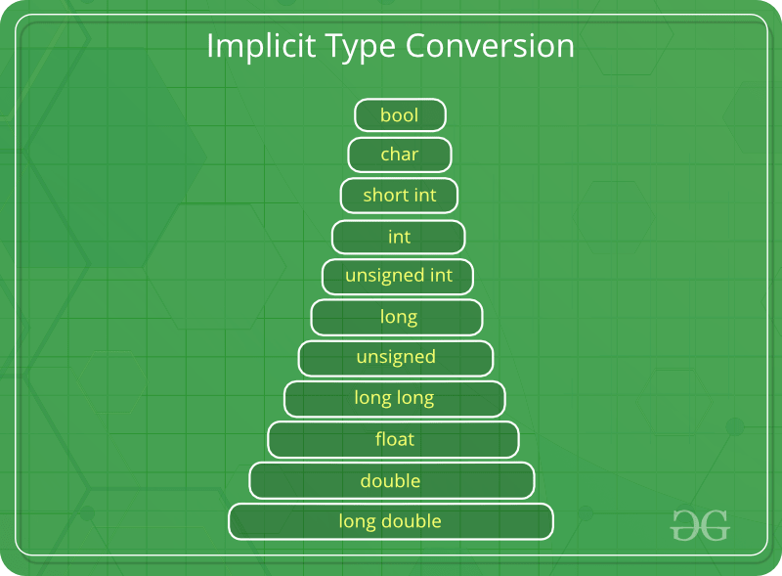
Implicit Type Conversion
Also known as ‘automatic type conversion’.
Done by the compiler on its own, without any external trigger from the user.
Generally takes place when in an expression more than one data type is present. In such condition type conversion (type promotion) takes place to avoid loss of data.
All the data types of the variables are upgraded to the data type of the variable with largest data type.
It is possible for implicit conversions to lose information, signs can be lost (when signed is implicitly converted to unsigned), and overflow can occur (when long long is implicitly converted to float).

Slide 115
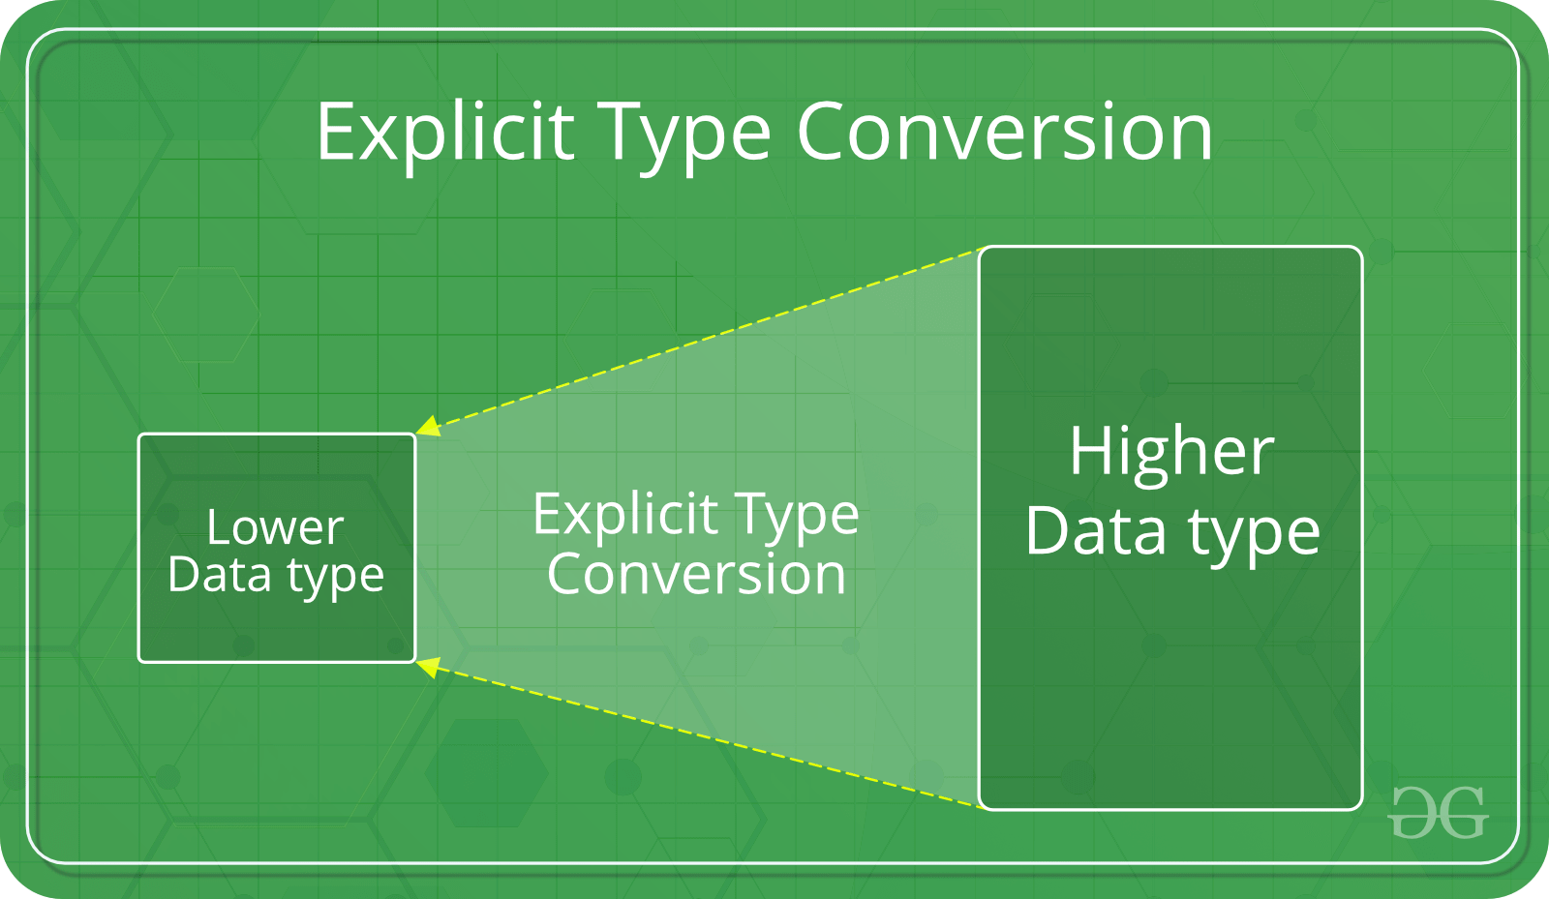
Explicit Type Conversion
This process is also called type casting and it is user defined. Here the user can type cast the result to make it of a particular data type.
The syntax in C:
(type) expression
Type indicated the data type to which the final result is converted.
Advantages of Type Conversion
This is done to take advantage of certain features of type hierarchies or type representations.
It helps us to compute expressions containing variables of different data types.

Slide 116
Expressions
Expressions are the statements or the instruction given to computer to perform some operation.
Every expression results in some value that can be stored in a variable.
Following are few example of expressions in program:
Expression to calculate speed of a car.
Speed=distance/time
Expression to find similarity of two things.
c=value1>value2
Notes:
A=b+c….three operands and 2 operators

Slide 117
Expressions in C are basically operators acting on operands.
An operand is an entity on which operation is to be performed.
An operator specifies the operation to be applied on operands.
Expressions are made of one or more operands.
Statements like :
a = b + c,
++z
300 > (8 * k)
Example: addition of two numbers, 5+8, these numbers will be operands.
Example: The addition, subtraction, etc will be operators

Slide 118
Sample program
#include<stdio.h> // Header File
#include <conio.h>
int b=10; //Global Declaration
void main ( ) /* main is the starting of every c program */
{
int a,c; //Local Declaration
clrscr( );
scanf(“%d”,&a);
printf(“ \n The sum of the two values:”);
c = a+b;
printf(“%d”,c);
getch( );
}

Slide 119
Sample program
#include<stdio.h>
#include <conio.h>
void main ( )
{
int a=10,b=4,c;
float d=3,e;
clrscr( );
c = a/b;
printf(" \n value a/b is:%d",c);
e = a/d;
printf("\n value a/d is:%f",e);
getch( );
}

Slide 120
Output
value a/b is:2
value a/d is:3.333333

Slide 121
Relational operator
It is used to compare two or more operands.
Eg :< , > , <= , >=, != etc,.
5 < 9 which will return 1

Slide 122
Logical operator
It is used to combine the result of two or more condition.
AND(&&)
OR (||)
NOT (!) are Logical operators.
Eg: (i>10)&&(j>5).
(i>10)||(j>5) etc,.

Slide 123
Sample program
#include<stdio.h>
#include <conio.h>
void main ( )
{
int a=10,b=3,c=5,e;
clrscr( );
if(a>b) // relational operator
{
printf(" \n a is bigger than b");
}
if((a>b)&&(a>c)) //Logical operator
{
printf(" \n a is biggest");
}
getch( );
}

Slide 124
Output
a is bigger than b
a is biggest

Slide 125
Assignment operator
It is used to assign a value or expression etc to a variable.
Eg: a =10.
a = b
a = b + c etc,.

Slide 126
Assignment operator(Cont)
Compound operator
It is also used to assign a value to a variable.
Eg: x + = y means x = x + y
Nested operator
It is used for multiple assignment.
Eg: i = j = k = 0;

Slide 127
Sample program
#include<stdio.h>
#include <conio.h>
int b=10;
void main ( )
{
int a=3,b=5;
clrscr( );
a+=b; // a= a+b
printf(" \n The sum of the two values:%d",a);
getch( );
}

Slide 128
Output
The sum of the two values:8

Slide 129
Increment or decrement operator(Unary)
It is used to Increment or decrement an operand.
Eg: ++x (Pre Increment),
x++ (Post Increment),
--x (Pre Decrement),
x-- (Post Decrement).

Slide 130
Sample Program
#include<stdio.h>
#include <conio.h>
void main ( )
{
int a=5;
clrscr( );
printf(" \n Post increment Value:%d",a++);
printf(" \n Pre increment Value:%d",++a);
printf(" \n Pre decrement Value:%d",--a);
printf(" \n Post decrement Value:%d",a--);
getch( );
}

Slide 131
Output
Post increment Value:5
Pre increment Value:7
Pre decrement Value:6
Post decrement Value:6

Slide 132
Bitwise operator
It is used to manipulate data at bit level.
Eg: a=5 i.e 0000 0101
b=4 i.e 0000 0100
Then a & b = 0000 0100
a | b = 0000 0101 etc,.

Slide 133
Sample program
#include<stdio.h>
#include <conio.h>
void main ( )
{
int a=5,b=4,c;
//char a=5,b=4,c;
clrscr( );
c = a&b;
printf(" \n value a&b is:%d",c);
getch( );
}

Slide 134
Output
value a&b is:4

Slide 135
Conditional Operator (or) Ternary Operator
It is used to checks the condition and execute the statement depending on the condition.
Eg: C = a > b ? a:b

Slide 136
Sample Program
#include<stdio.h>
#include <conio.h>
void main ( )
{
int a=5,b=8,c;
clrscr( );
c = a>b?a:b; //Conditional operator
printf(" \n The Larger Value is%d",c);
getch( );
}

Slide 137
Output
The Larger Value is 8

Slide 138
Special Operator
comma operator ( , )
sizeof operator
pointer operator (& , *) etc,.

Slide 139
#include<stdio.h>
#include <conio.h>
void main ( )
{
int c;
clrscr( );
printf(" \n size of int is:%d",sizeof c);
getch( );
}

Slide 140
Output
size of int is: 2

Slide 141
Plan for Next Class
Review of Expressions
Statements
Statements vs. Expressions

Slide 142
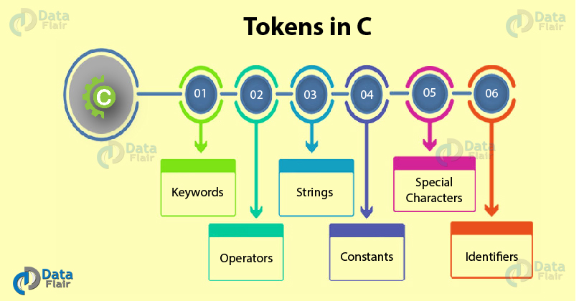

Slide 143
Keywords in C
Keywords in C language are the pre-defined & reserved words, each having its own significance and hence has a specific function associated with it.
We can’t simply use keywords for assigning variable names, as it would connote a totally different meaning altogether and would be erroneous.
There are a total of 32 keywords offered in C.
Key takeaway: All the keywords in C are lowercase in nature.
auto | break | case | char
continue | do | default | const
double | else | enum | extern
for | If | goto | float
int | Long | register | return
signed | static | sizeof | short
struct | switch | typedef | union
void | while | volatile | unsigned

Slide 144
User Defined Identifiers in C
The C programmer has the provision to give names of his own choice to variables, arrays, and functions. These are called identifiers in C. The user may use the combination of different character sets available in the C language to name an identifier but, there are certain rules to be abided by the user on his part when naming identifiers, otherwise the situation would prove to be dicey.
Rules for Identifiers in C –
First character: The first character of the identifier should necessarily begin with either an alphabet or an underscore. It cannot begin with a digit.
No special characters: C does not support the use of special characters while naming an identifier. For instance, special characters like comma or punctuation marks can’t be used.
No keywords: The use of keywords as identifiers is strictly prohibited, as they are reserved words which we have already discussed.
No white space: White spaces include blank spaces, newline, carriage return, and horizontal tab, which can’t be used.
Word limit: The identifier name can have an arbitrarily long sequence that should not exceed 31 characters, otherwise, it would be insignificant.
Case sensitive: Uppercase and lowercase characters are treated differently.

